Slide 1
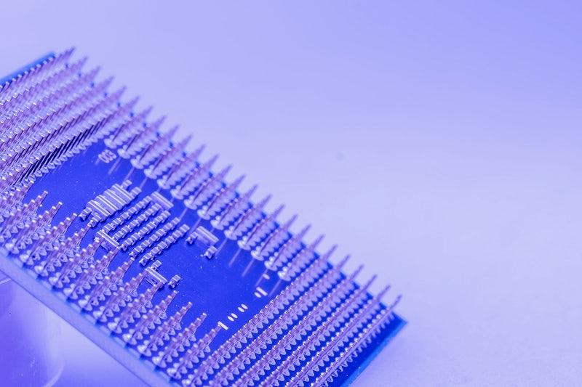
Testing and Maintenance

Slide 2
Testing of circuit layout
Design Verification Testing (DVT): This involves testing the initial prototype of the circuit layout to verify its functionality according to the design specifications. DVT ensures that the circuit performs its intended tasks correctly.
Functional Testing: This testing verifies whether the circuit performs its intended functions correctly. It involves applying input signals and observing the output responses to ensure they match the expected behavior.

Slide 3
Signal Integrity Testing: Signal integrity testing ensures that the signals transmitted through the circuit layout are not distorted or degraded. High-speed digital circuits may require careful analysis of signal integrity to prevent data errors or malfunctions.
Power Integrity Testing: Power integrity testing ensures that the power distribution within the circuit is stable and meets the voltage and current requirements of various components.

Slide 4
Environmental Testing: Circuits may be subjected to different environmental conditions, such as temperature, humidity, and vibration, to ensure they operate reliably under varying circumstances.
Electromagnetic Compatibility (EMC) Testing: EMC testing checks whether the circuit layout emits electromagnetic interference (EMI) that could interfere with other devices or is susceptible to external EMI.

Slide 5
Maintenance
Regular Inspections: Conduct routine visual inspections to check for physical damage, loose connections, or signs of wear and tear. Inspections help catch potential issues before they escalate.
Component Aging and Replacement: Electronic components can degrade over time due to factors like temperature, voltage stress, and usage. Regularly monitor component lifetimes and replace aging or faulty components to prevent failures.

Slide 6
Firmware and Software Updates: If the circuit layout includes programmable components or microcontrollers, ensure that firmware and software are updated as needed to address bugs, vulnerabilities, or improve performance.
Backup and Documentation: Maintain thorough documentation of the circuit layout, design changes, test results, and maintenance activities. Regularly back up design files to prevent data loss.

